Slide 1


Asha M. Tarsadia Institute of
Computer Science and Technology
Presentation-2
BIKE SHOWROOM MANAGEMENT SYSTEM
Prepared by
Ritesh Jayantibhai Bhusara (202303103510153)
Guided by
Prof.Vidhi Sutaria Mam

Slide 2
Introduction
Purpose
This project can be used by showroom agencies for keeping the records of their customer and manage product availability on users web page.In the proposed system we do not need to maintain records or everything manually,if any enquiry occurs it is done automatically because DBMS gives facility of having relationship between table

Slide 3
Introduction
Scope
Admin:
The system will serve as an integrated platform to manage inventory management , mainataining customers ,records,
providing slots and timing for test drives ,tracking sales and generating reports
User:
The system will help user to view details and features of vehicles, they has ability to book a test drives, order a vehicle in advance ,track their orders and make payments

Slide 4
Introduction
References:
Chatbots
YouTube
Bootstrap
Tools and technology used in project
Front-end: HTML, CSS
Back-end: PHP, MYSQL
Environment: VSCODE , XAMPP
Documentation and Presentation: MS Word, MS Presentation
Diagrams: Visual Paradigm , LucidChart

Slide 5
Overall Description
Product Perspective:
The Showroom Management System will be a standalone web-based application, providing efficient and user-friendly operations for showroom management. The system will help track sales, manage customer information, update inventory levels, and generate reports. It will have role-based access for Admin and Users.
Product Functions:
Home Page
Menu Section
User Registration and Login
Cart and Online Ordering

Slide 6
Overall Description
Product Features
Inventory Management: Track the availability of bikes and accessories, add new bikes, update existing inventory, and view stock levels.
Sales Management: Process customer orders, issue invoices, and update the inventory upon sale completion.
Customer Management: Store customer details, purchase history, and preferences.
Reporting: Generate sales, inventory, and financial reports.
User Management: Manage users (Admin and Users roles) with restricted access based on roles.

Slide 7
Overall Description
Characteristics:
Admin:
Full control over the system with access to all modules, including inventory, sales, customer management, and reporting
Users: Interacts indirectly with the system through the purchase process.

Slide 8
System Features
Registration and Login
Product Information Display
Cart and Online Ordering
Tracking Order
Admin Panel
Special Offers on Trending Products
Social Media Integration

Slide 9
Functional Requirements
Admin:
ID | Title and Description
FR1 | Title: Registration & Login Description: Allows admin to access admin panel.
FR2 | Title: Manages Inventory Description: Allows admin to add, edit or delete the vehicles list from inventory .
FR3 | Title: Manages Customers records Description: Allows Admin to manage the records of users and customers.
FR4 | Title: Track the sales Description: Admin has ability to track the sales that he/she must make a proper plan to increase sales.
FR5 | Title: Generate Reports Description: Admin can create reports.

Slide 10
Functional Requirements
User:
ID | Title and Description
FR1 | Title: Registration Description: Used to register new users in the system, allowing them to create an account
FR2 | Title: Login and Password Management Description: Provides secure login and password management for users, ensuring their accounts are protected.
FR3 | Title: Home page Description: Displays the Vehicles available for sale and test drives.
FR4 | Title: Booking a test drive or ordering a vehicles Description: Allows users to book a test drive or order a vehicle in advance
FR5 | Title: Payment Description: Allows users to make payments for their orders
FR6 | Title: Tracking Orders Description: User are able to track their orders or get conformation on their test drives slots.

Slide 11
Non-Functional Requirements
ID | Title and Description
NFR1 | Title: Performance Requirements Description: The website should load quickly and provide a smooth user experience.
NFR2 | Title: Safety Requirements Description: The website must implement HTTPS for secure data transmission and protect user information.
NFR3 | Title: Usability Requirements Description: The interface should be intuitive and easy to navigate for all users.
NFR4 | Title: Reliability Requirements Description: The system shall perform automatic daily backups to ensure data is preserved.
NFR5 | Title: Maintainability Description: The system shall be modular to allow for easy maintenance and future updates.

Slide 12
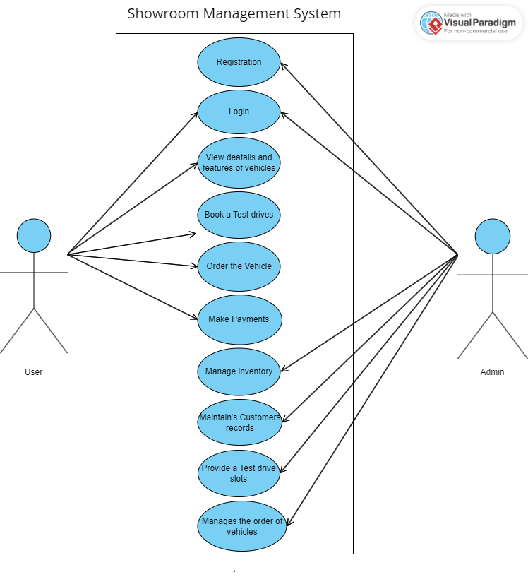
Use Case Diagram

Slide 13
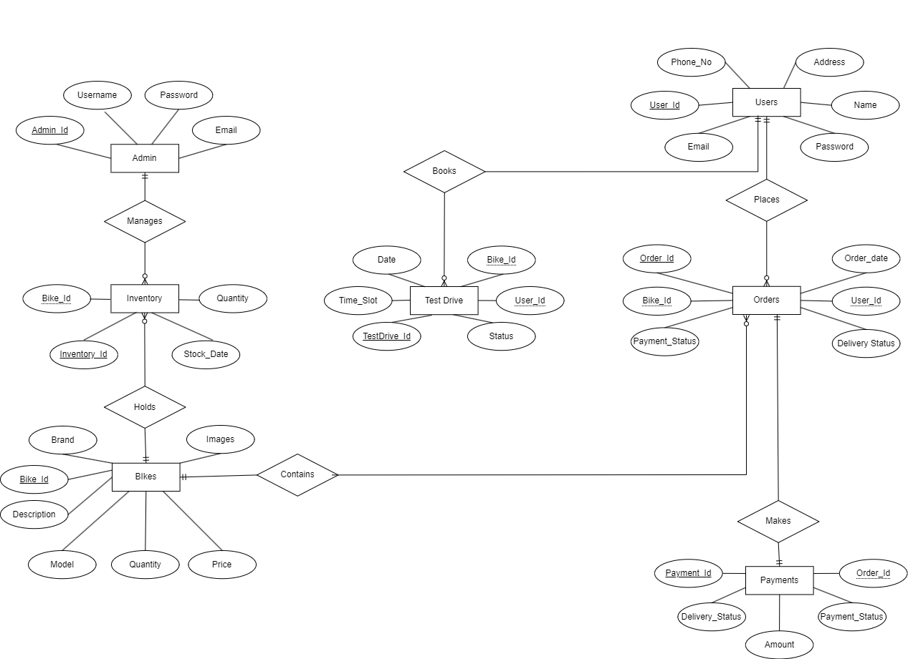
ER Diagram

Slide 14
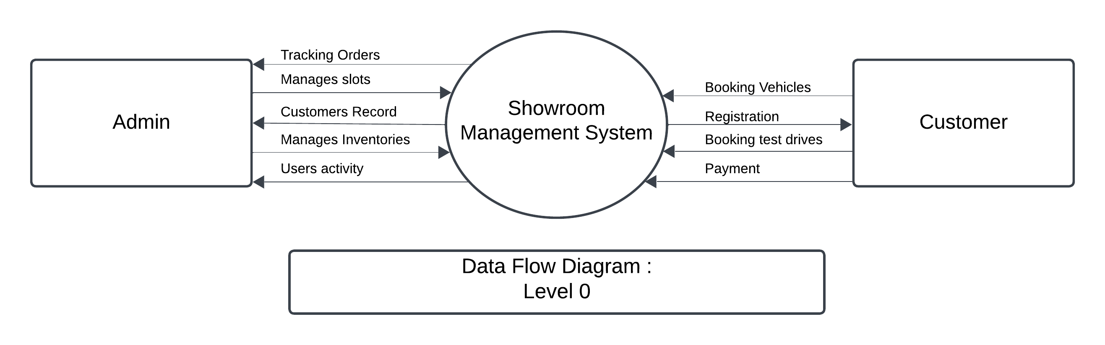
DFD Diagram(Level 0)

Slide 15
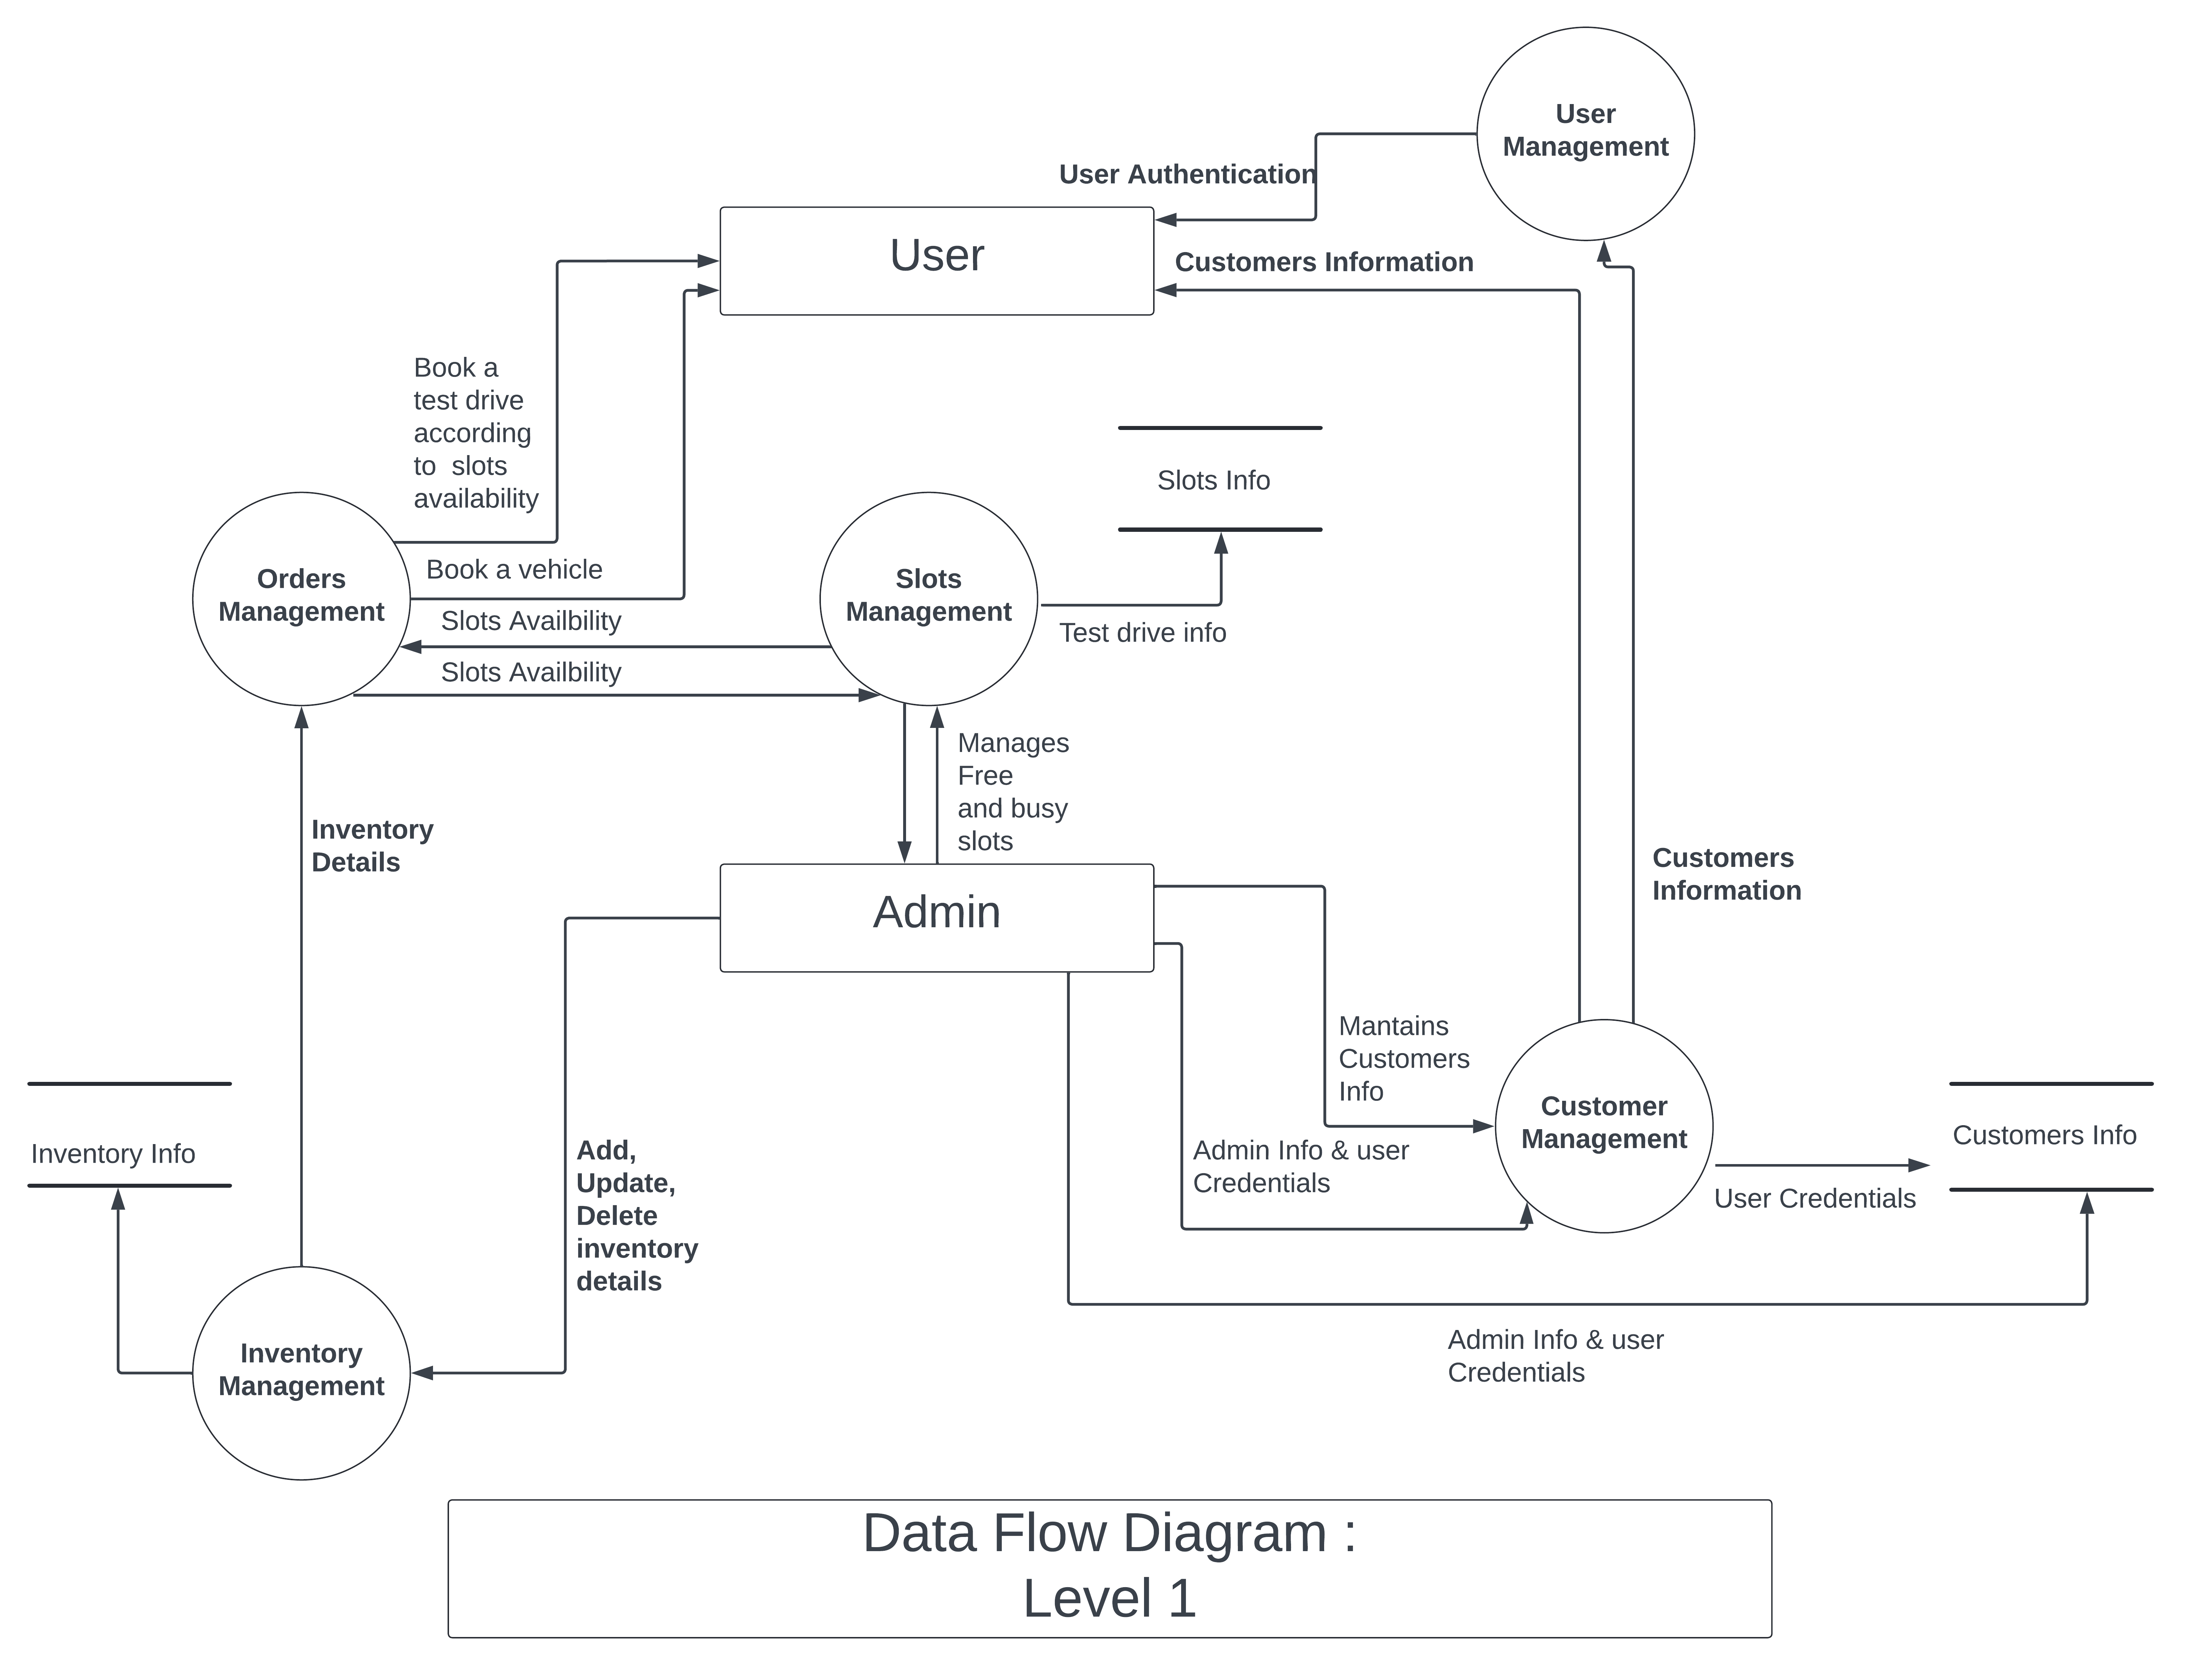
DFD Diagram (Level 1)

Slide 16
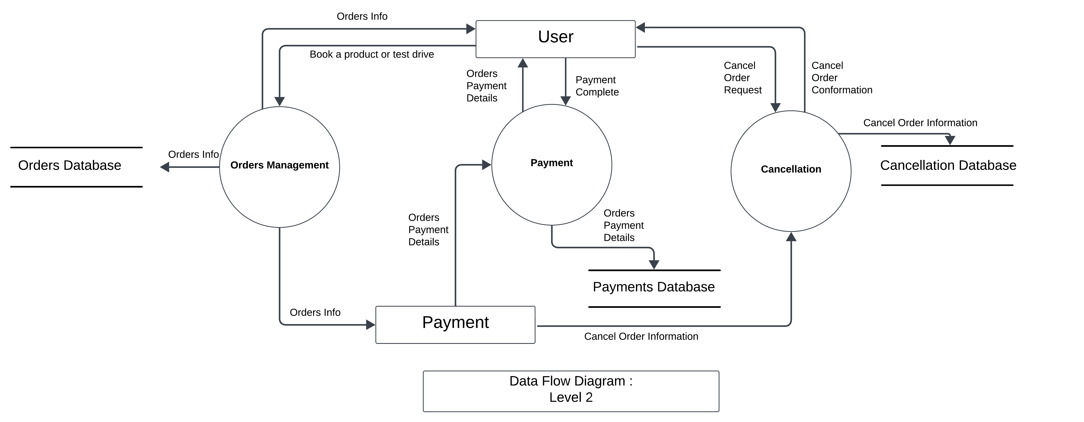
DFD Diagram (Level 2)

Slide 17
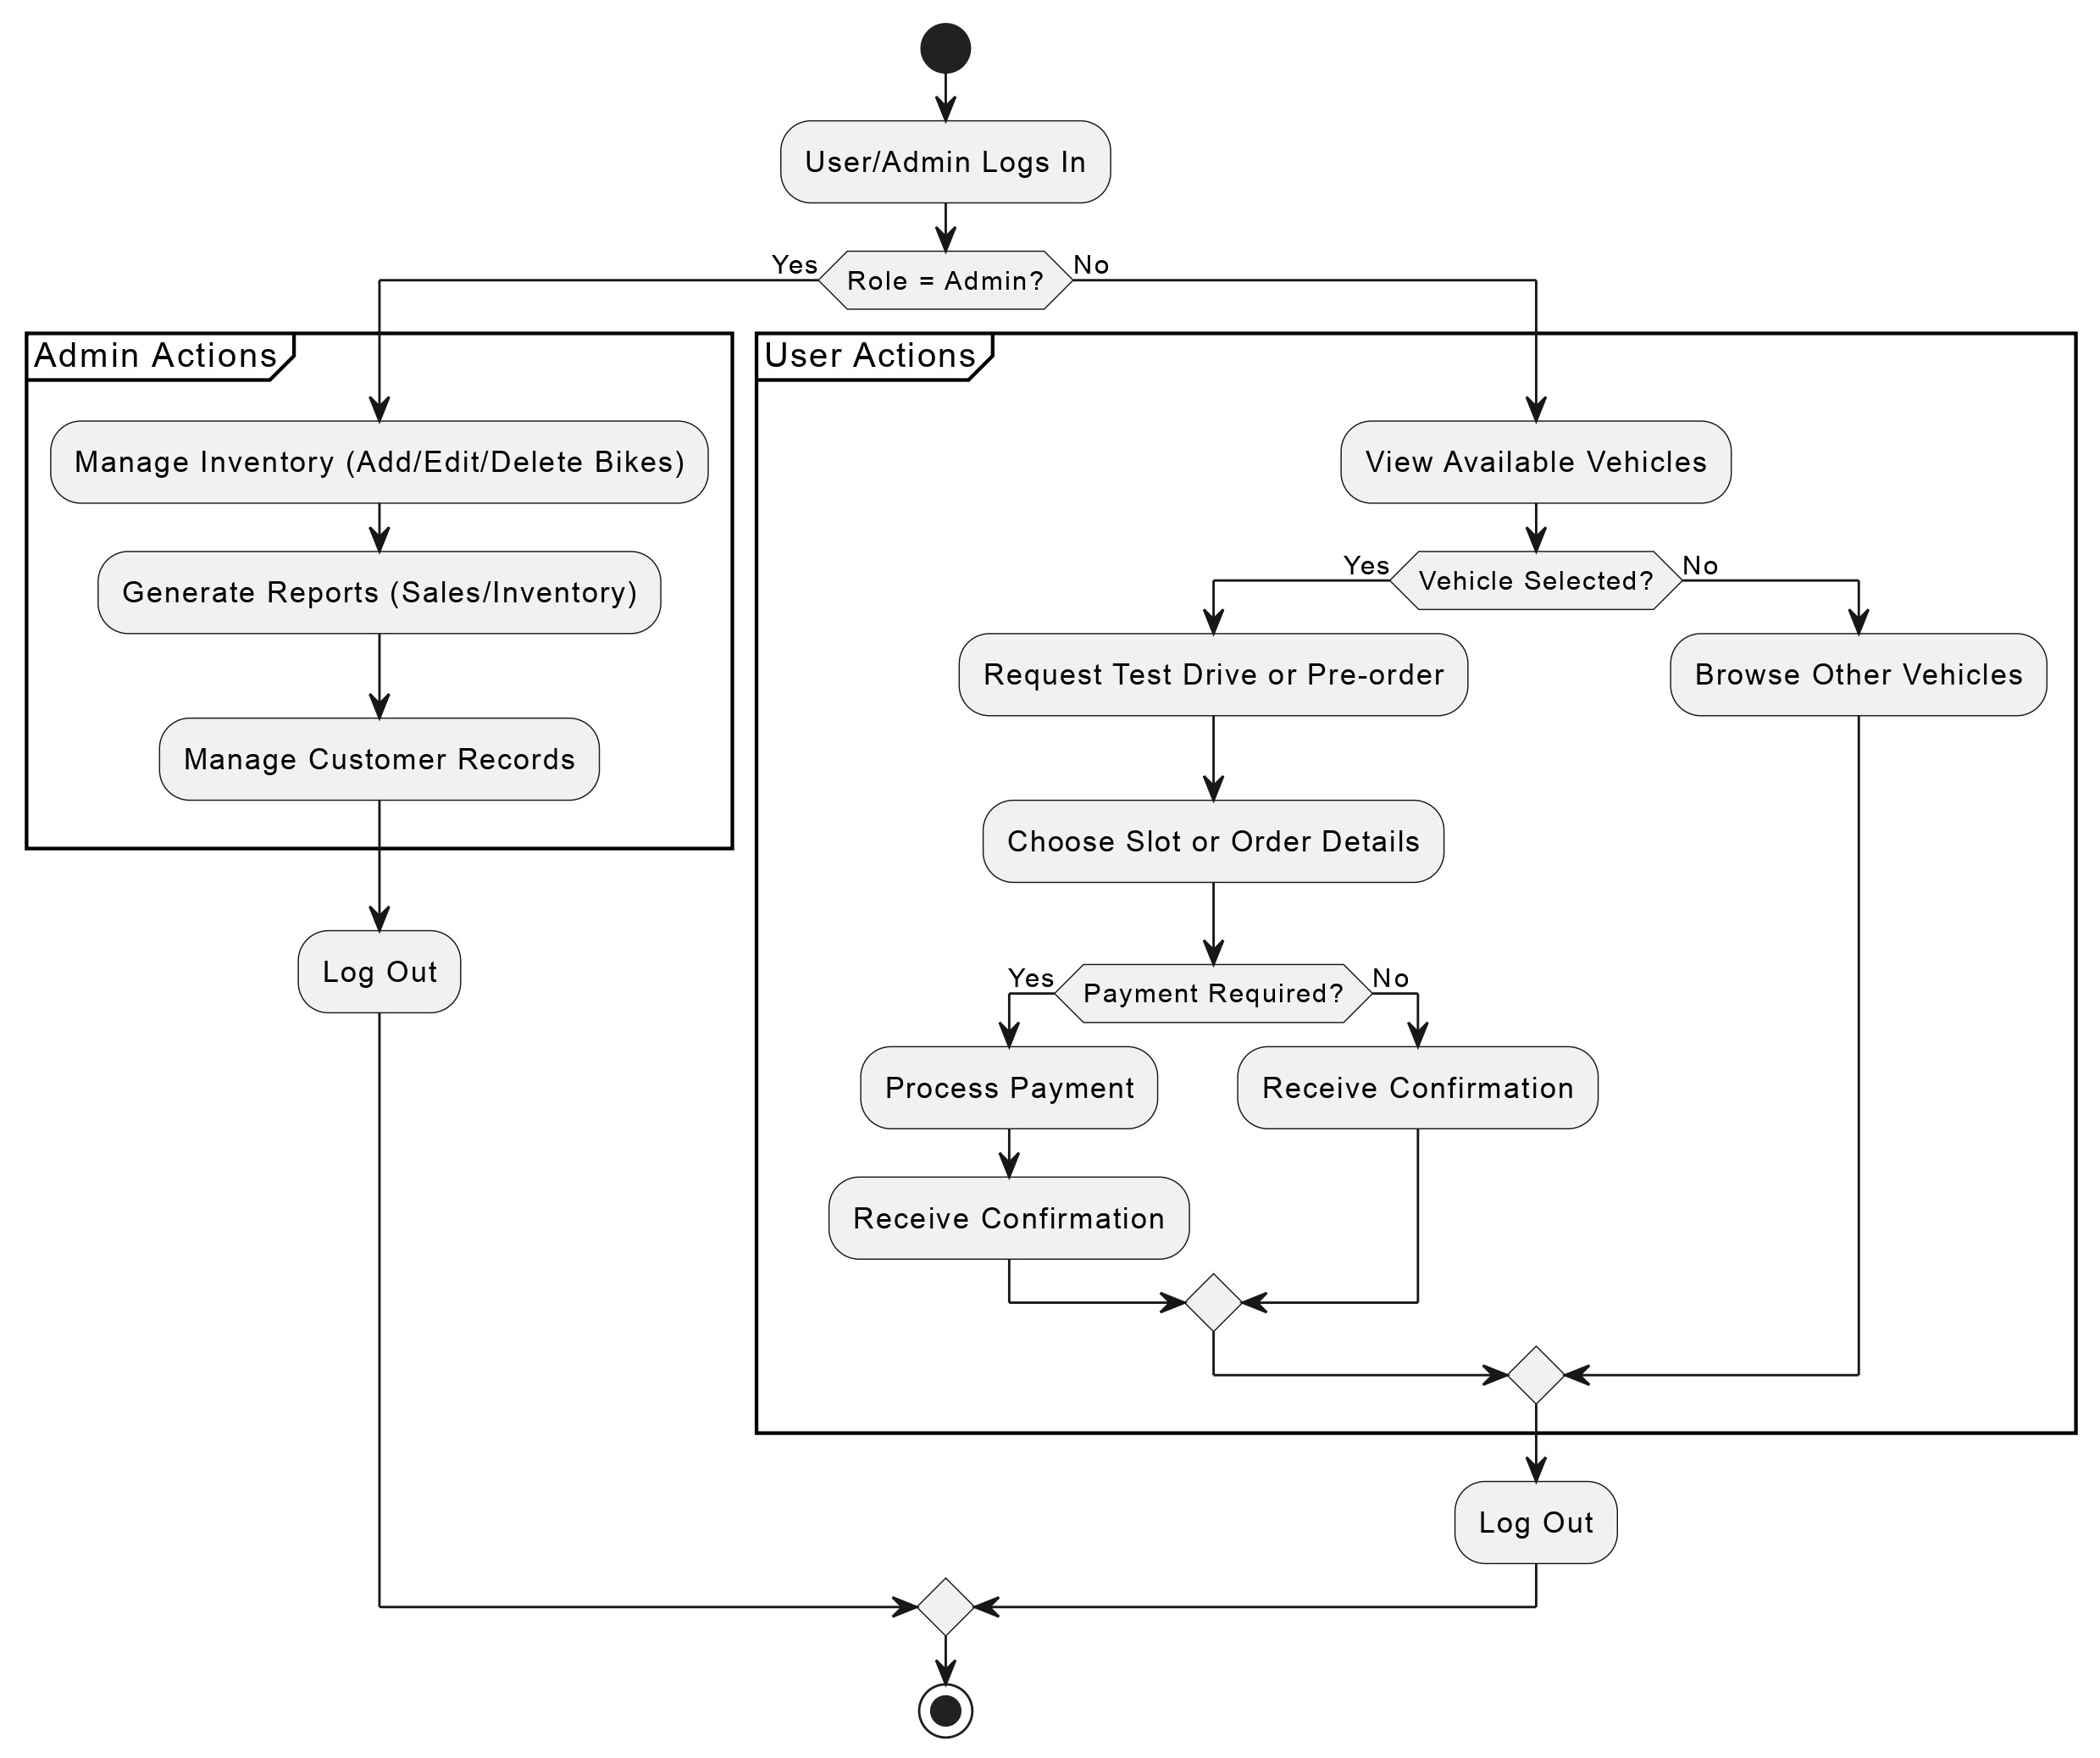
Activity Diagram

Slide 18
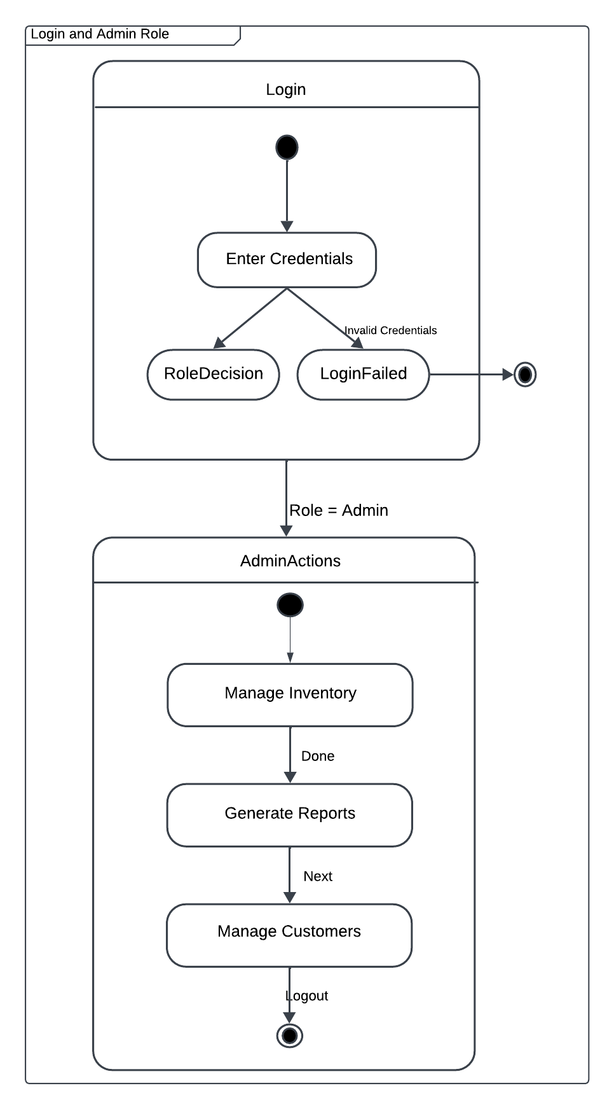
State Diagram

Slide 19
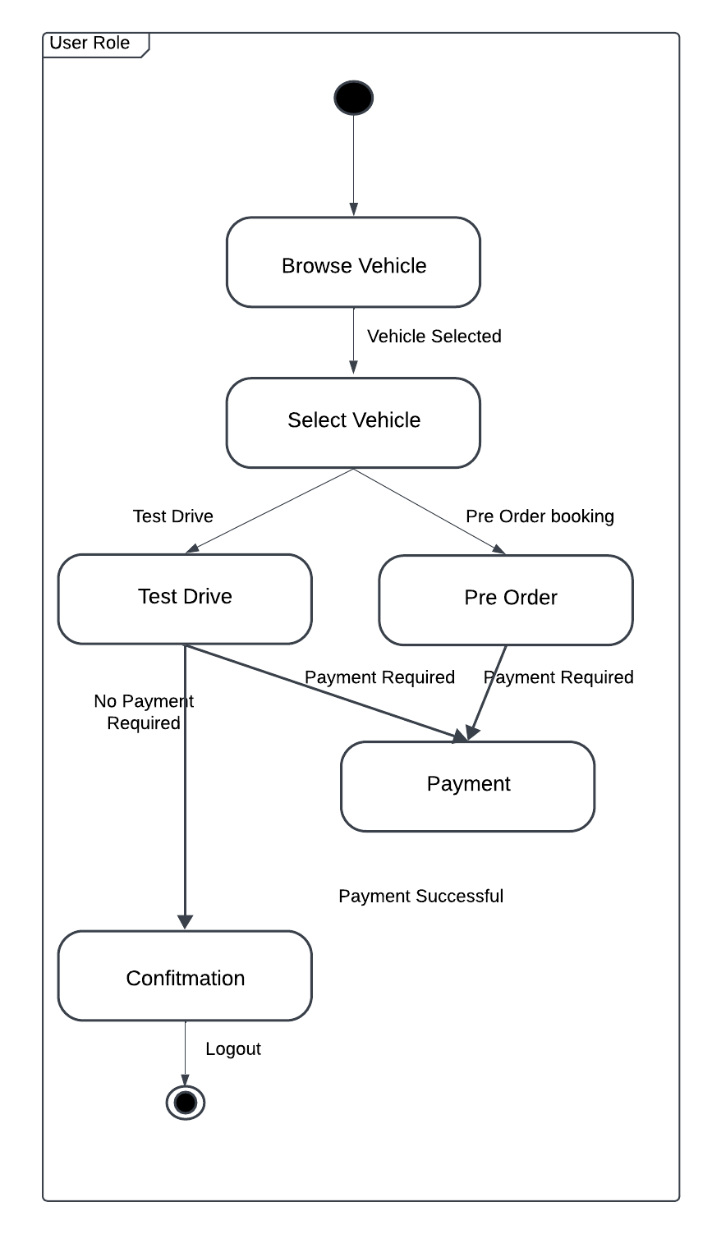
State Diagram

Slide 20
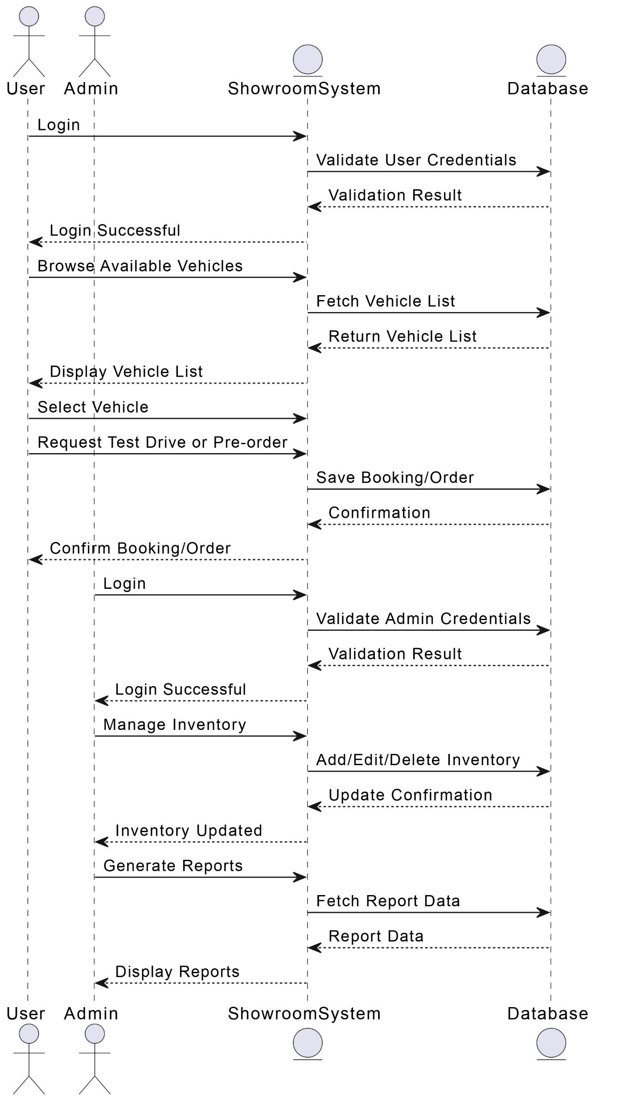
Sequence Diagram

Slide 21
Conclusion
The Showroom Management System will enhance the operational efficiency of a bike showroom by automating tasks related to inventory, sales, customer management, and reporting. With its user-friendly interface, real-time updates, and secure architecture, the system ensures smooth day-to-day operations and improved customer service. By streamlining workflows and providing useful analytics, the system helps showroom managers make informed decisions, thus contributing to overall business growth. This SRS provides a comprehensive roadmap for building a robust and scalable system tailored to the specific needs of a bike showroom.

Slide 22
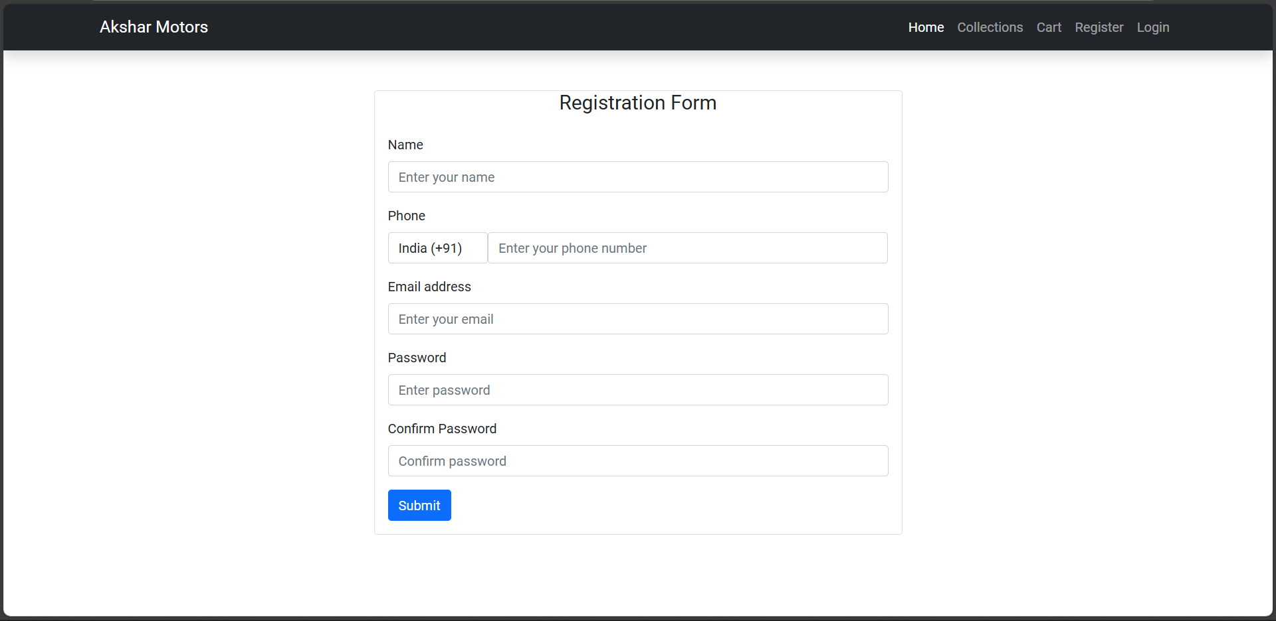
Project Progression
Registration Page

Slide 23
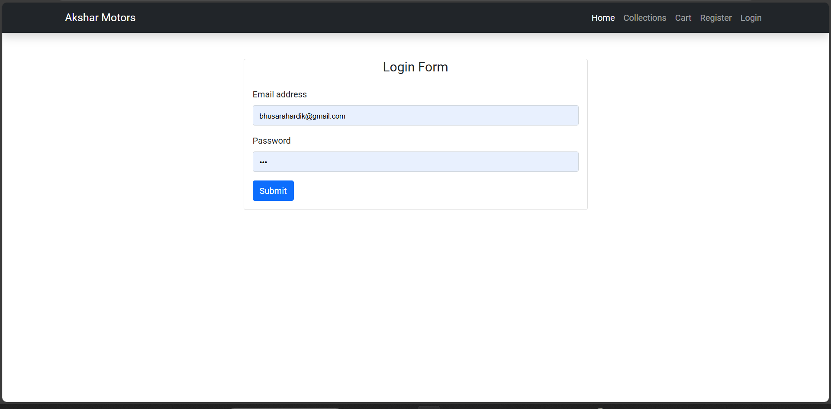
Project Progression
Login Page

Slide 24
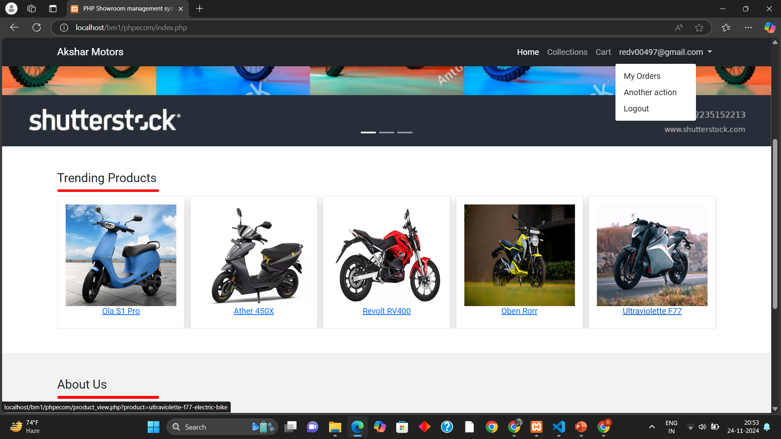
Project Progression
User Home Page

Slide 25
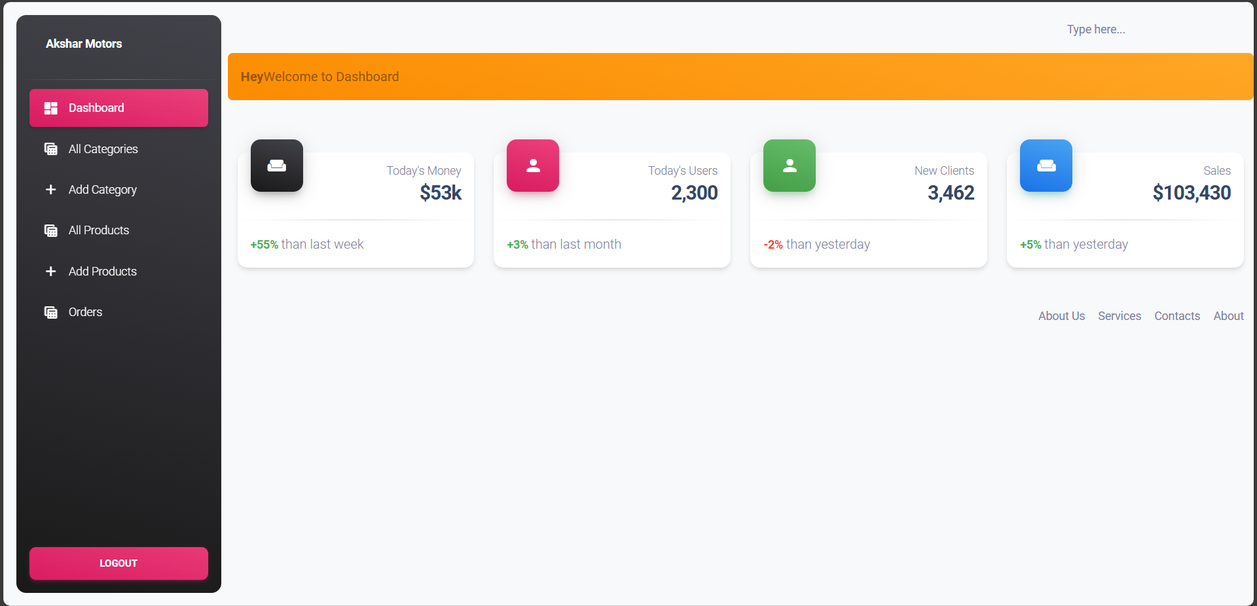
Project Progression
Admin Dashboard

Slide 26
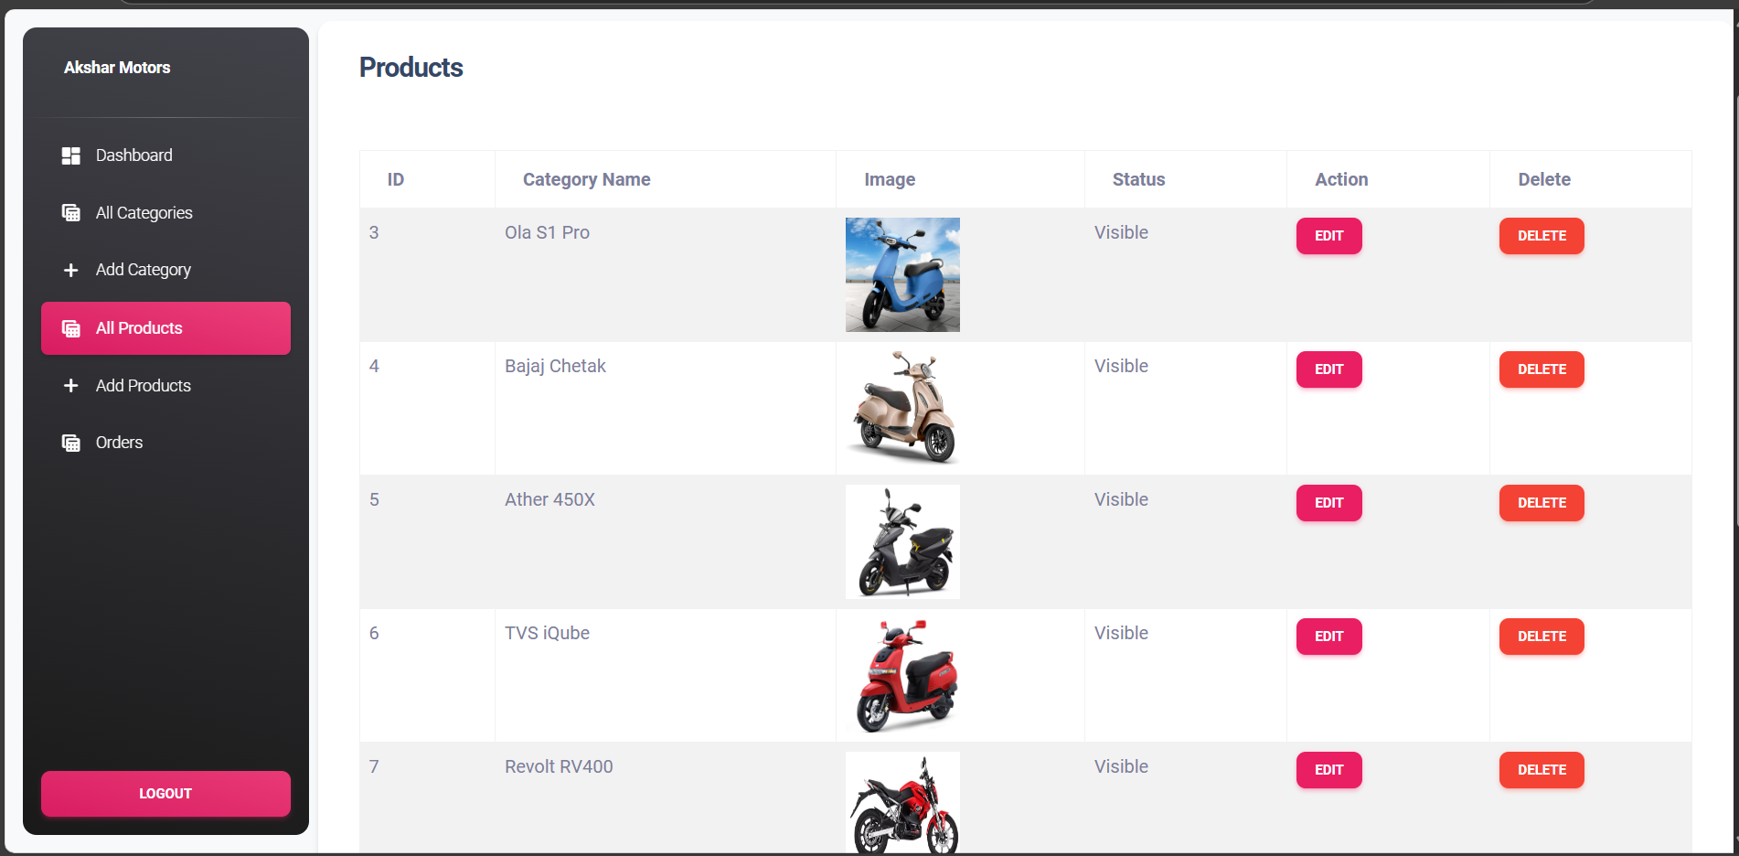
Project Progression
Manage Products

Slide 27
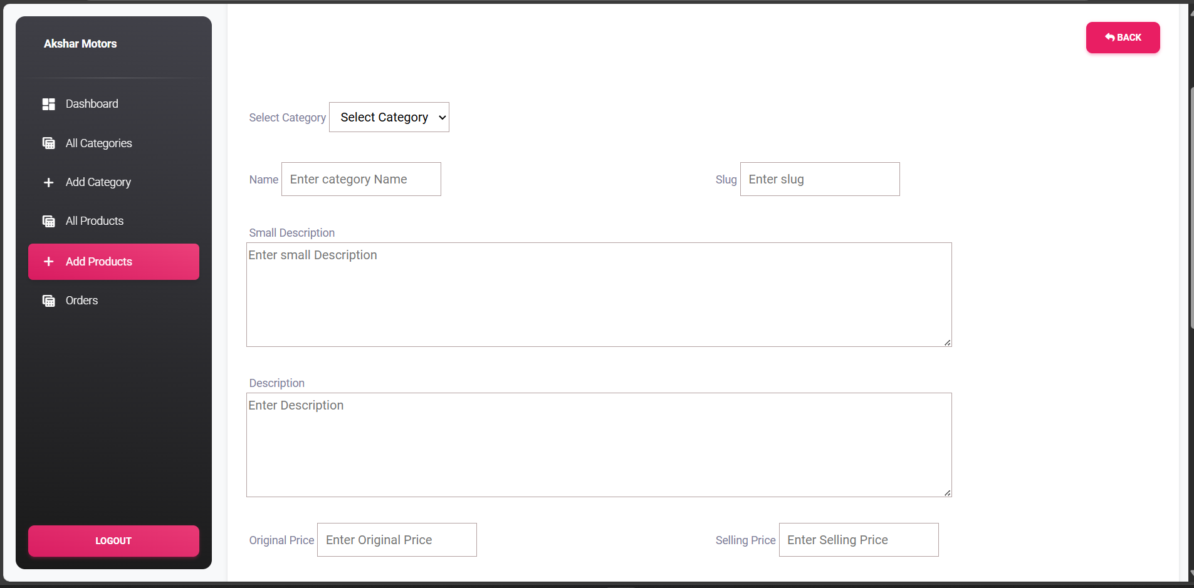
Project Progression
Add Products

Slide 28
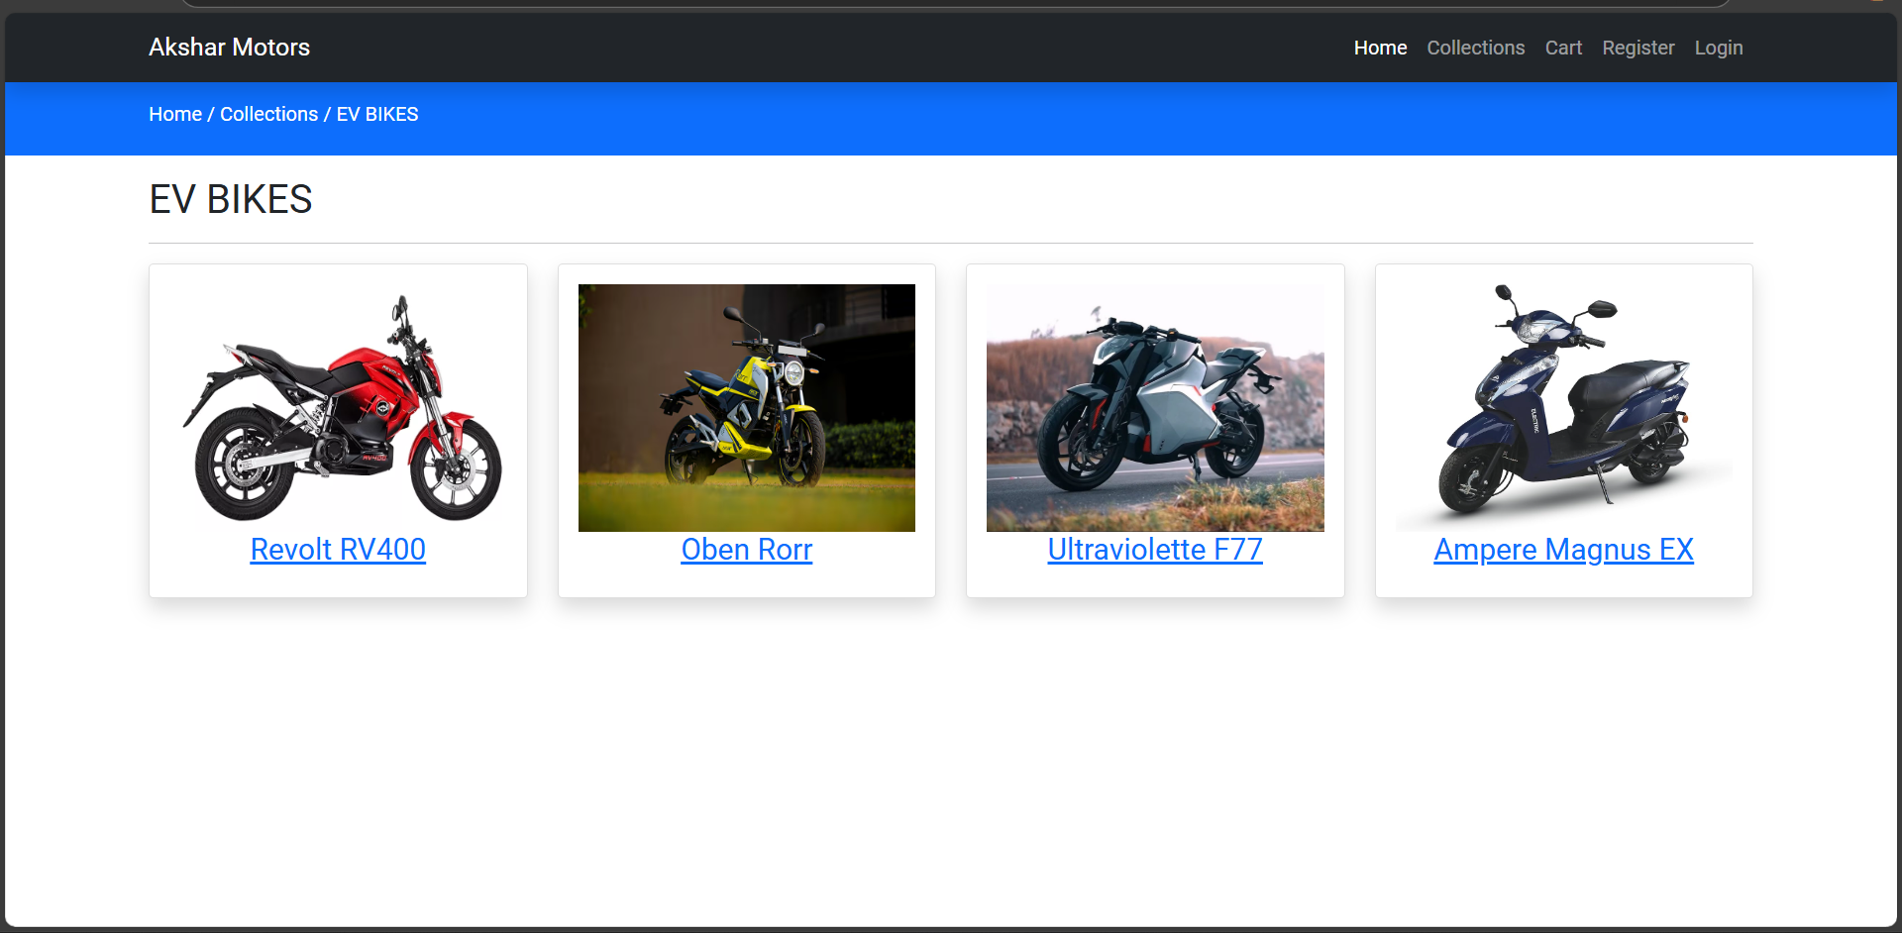
Project Progression
User Viewing Products

Slide 29
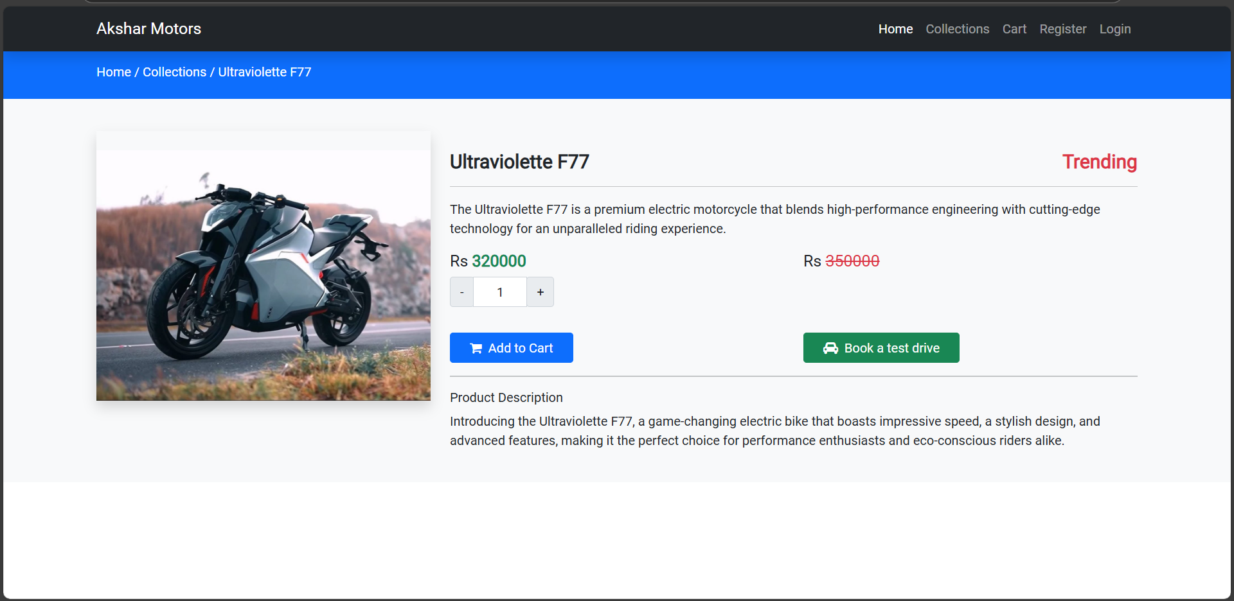
Project Progression
View Product

Slide 30
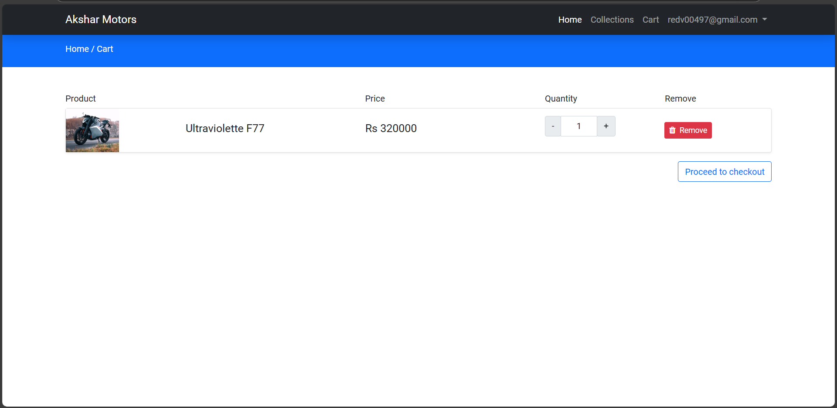
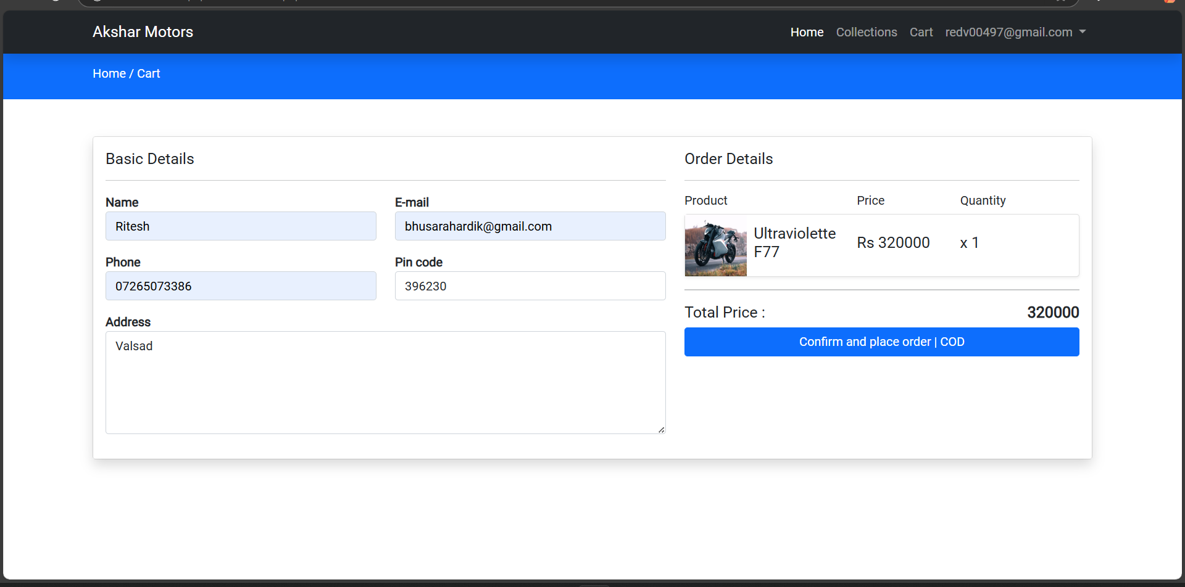
Project Progression
View Cart And Checkout

Slide 31
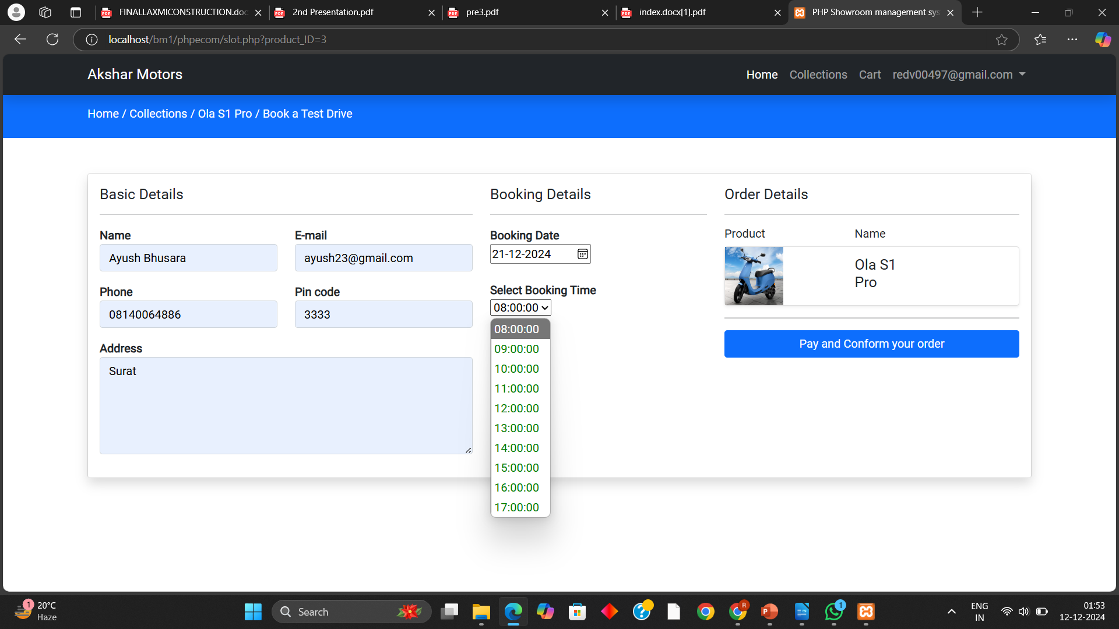
Project Progression
Book A Test Drive

Slide 32
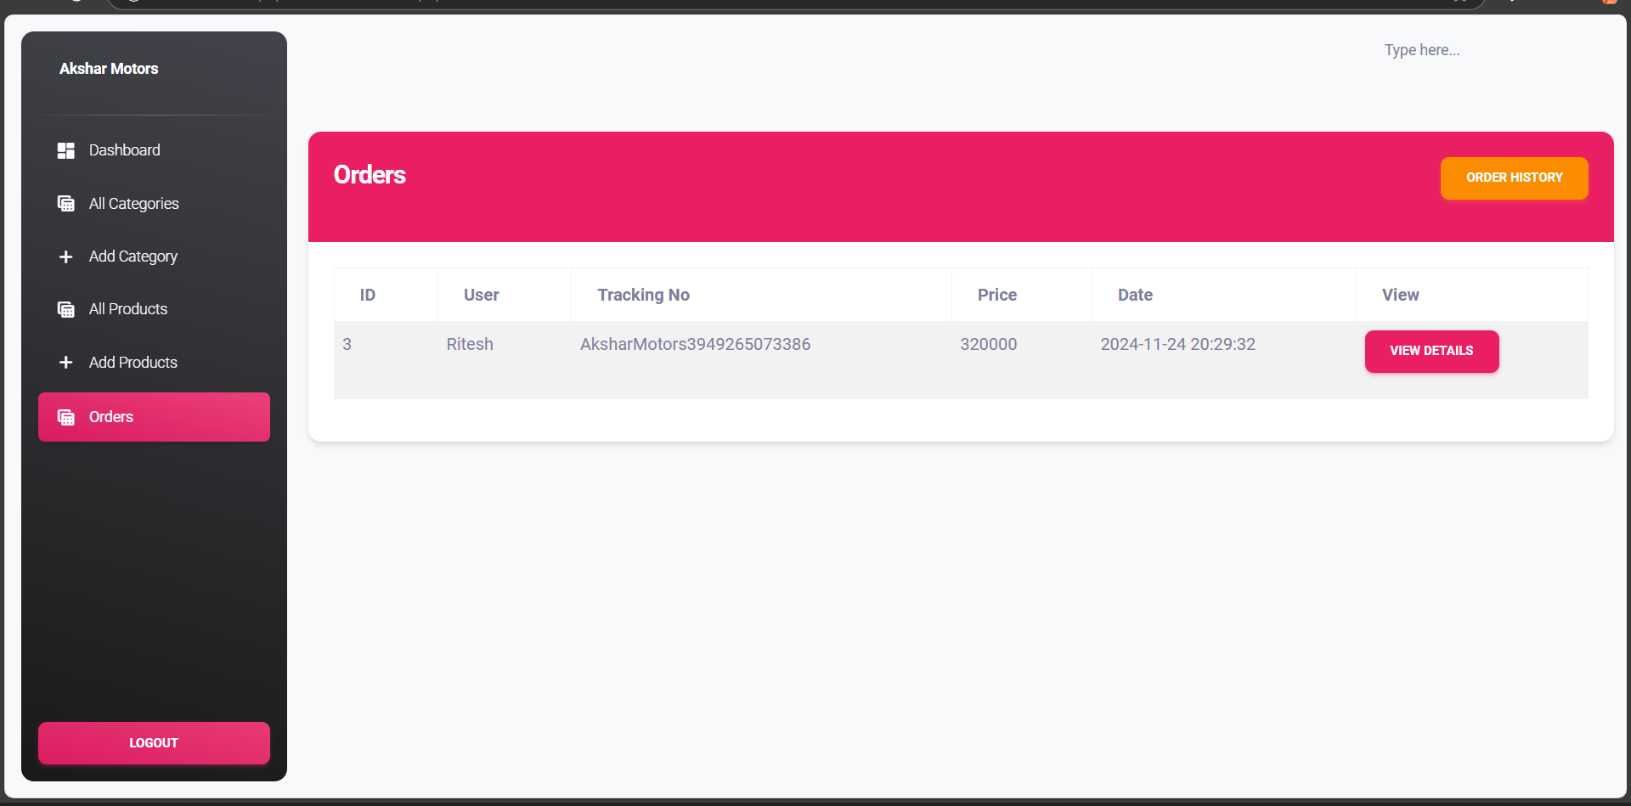
Project Progression
Orders on Admin side

Slide 33
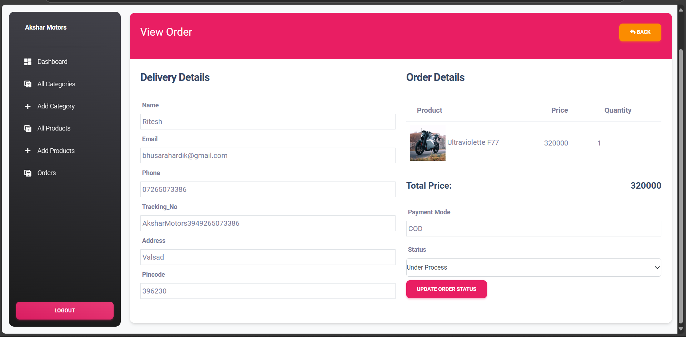
Project Progression
Orders on Admin side

Slide 34
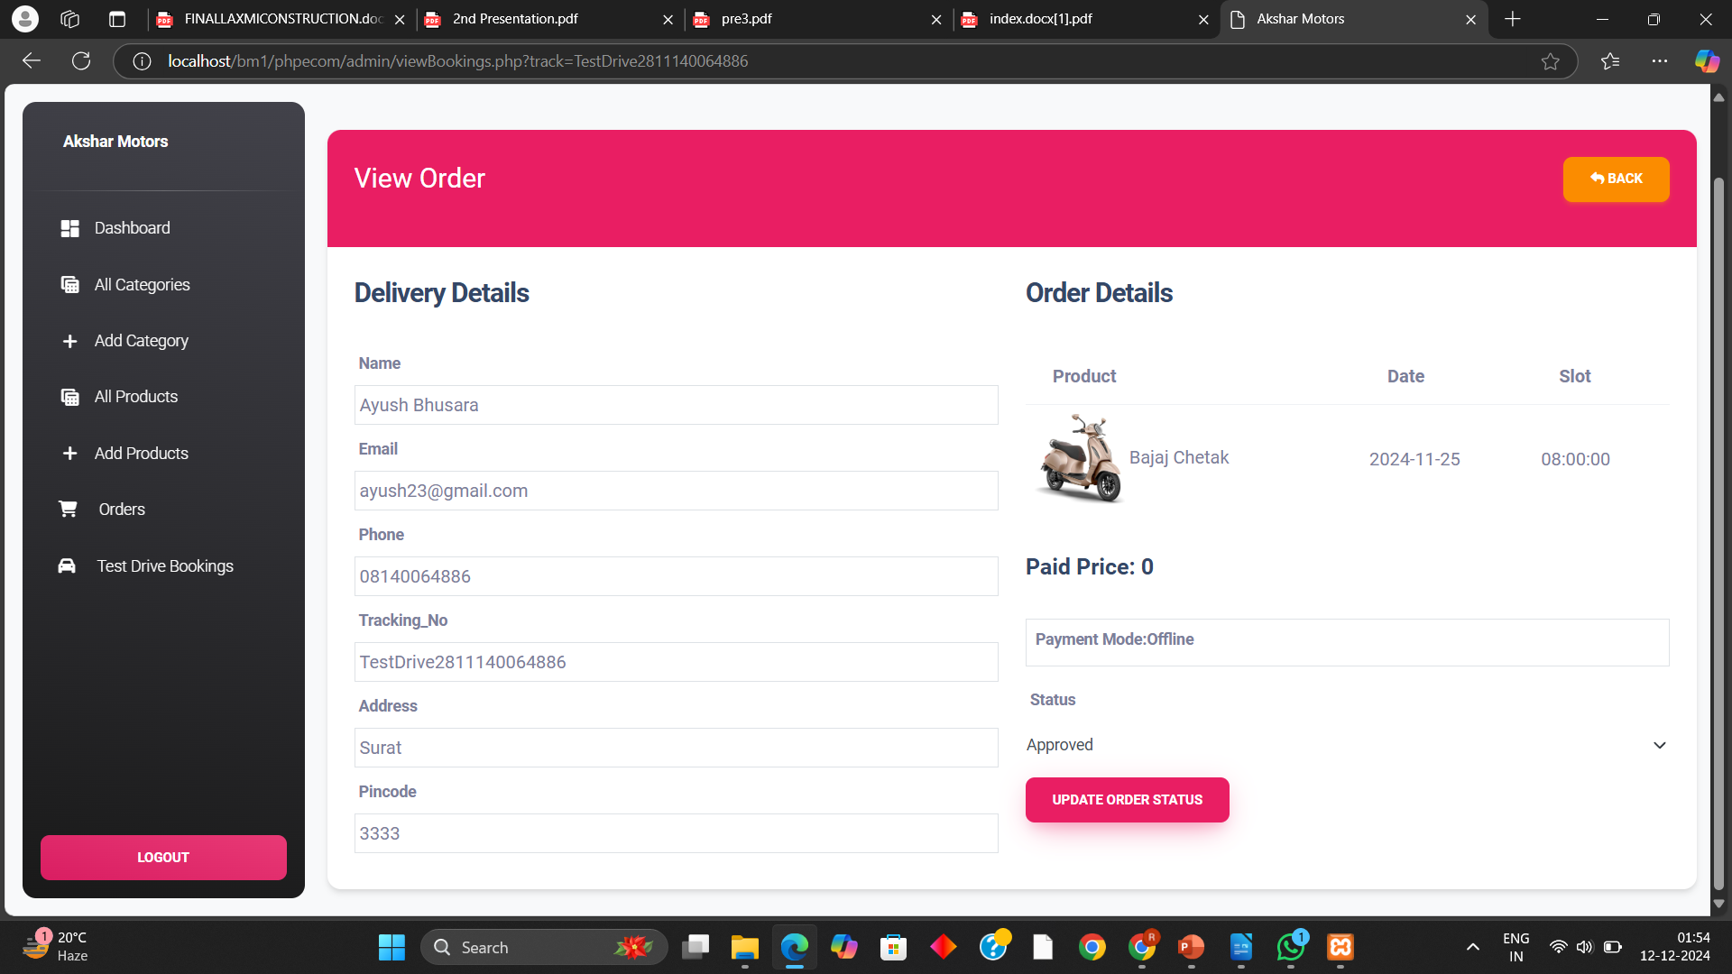
Project Progression
Admin Approving For Test Drive

Slide 35
THANK YOU!

